Slide 1

Myself in June 2017

Slide 2
The risk: job loss impacts you mental wellbeing… After 12 week mental health risks increase

Slide 3
People who are unemployed consult their GPs more often than the general population. Depression and anxiety are 4-10 times more prevalent among people who have been unemployed for more than 12 weeks Royal College of Psychiatrists, 2008

Slide 4
The opportunity for DWP Mental health support for people newly out of work…

Slide 5

The opportunity for DWP Being seen as a friend rather than a foe by humanizing the service

Slide 6
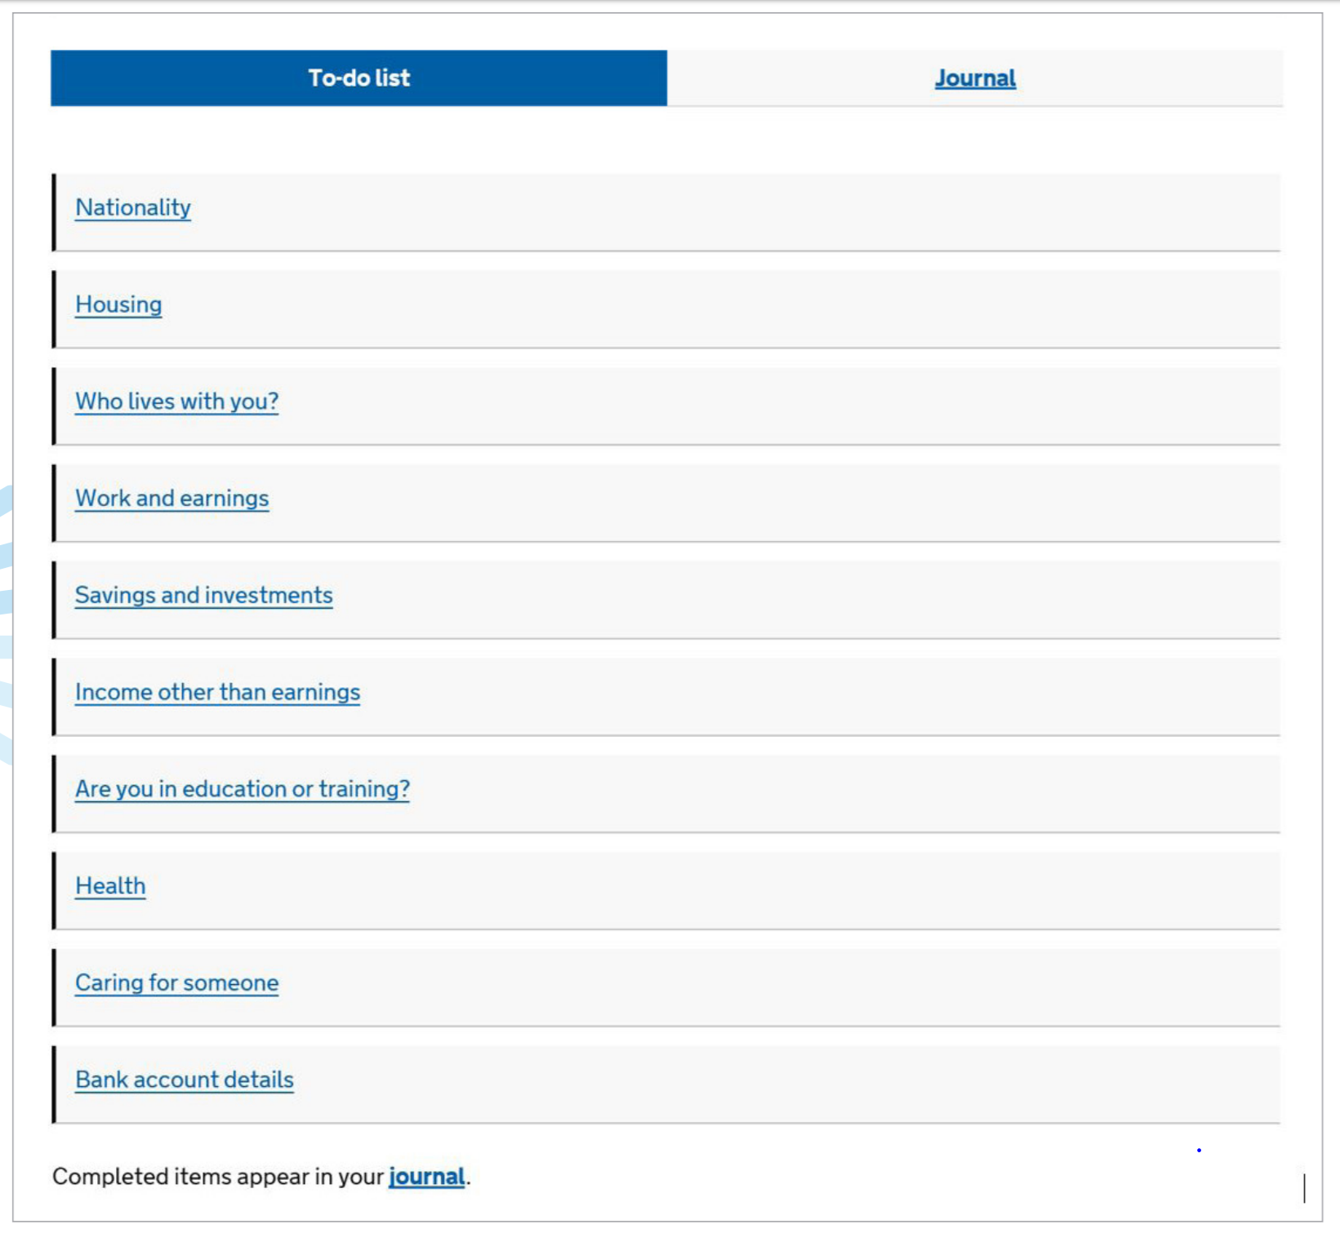
How do we engage people? A/B Test Option A Opportunity when they apply for universal credit

Slide 7
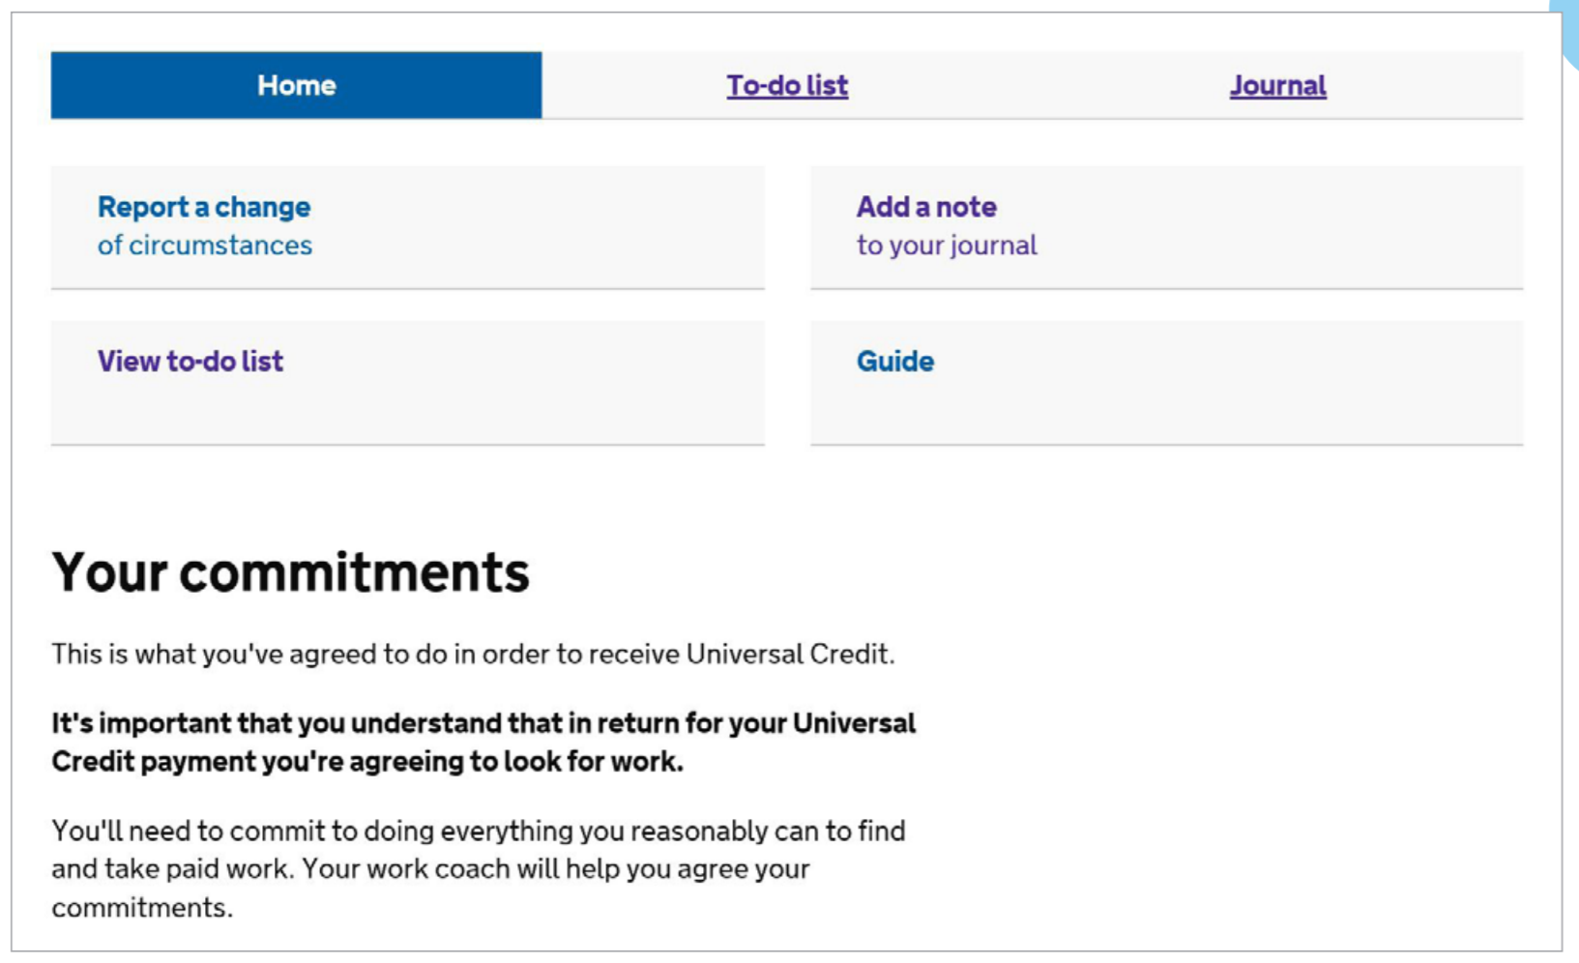
How do we engage people? A/B Test Option B Opportunity when they have finished the process or in the last stages or in their account summary

Slide 8
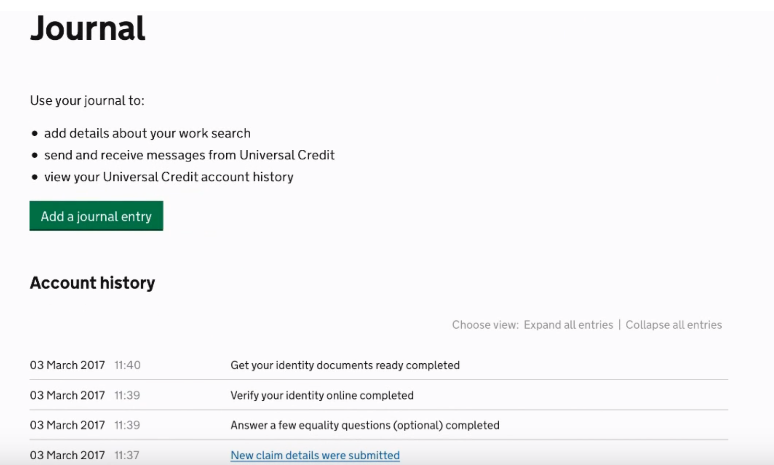
How do we engage people? A/B Test Option B Opportunity when they have finished the process or in the last stages or in their account summary

Slide 9
How to avoid people being scared of using the app? - Make clear that the usage of the app does not have any relation with payments of benefits -→ gain trust

Slide 10
KPIs to measure performance - Answers to how are you feeling today? AVG score along a timeline - Usage increase or decrease after x amount of days - Download of apps and active users, web visits – average session duration - Referrals to other apps (Calm, HeadSpace, FutureLearn) and active users there

Slide 11
Second stage - Interaction with job coaches - NHS data sharing - Coordination with NHS apps (be Mindful)

